Slide 1

Factors Associated with High Income Micro-Project #2 https://github.com/jpadwor1/ANA500
John Padworski
10/12/2025

Slide 2
Problem Statement
We aim to understand which demographic and work-related factors are associated with higher income in the Adult Income dataset. Specifically, we will explore how variables such as age, education, occupation, work hours, marital status, and capital gains/losses relate to the probability that an individual’s annual income exceeds $50K.

Slide 3
Hypothesis Formulation
H1 (Education): Individuals with higher education-num have a higher probability of income == >50K than those with lower education-num.
H0: Mean high-income rate is equal across education levels.
HA: Mean high-income rate increases with education level.
H2 (Work hours): hours-per-week is positively associated with >50K income.
H0: Mean hours are equal between <=50K and >50K.
HA: Mean hours are higher in the >50K group.
H3 (Marital status): Being married (e.g., Married-civ-spouse) is associated with a higher >50K rate compared with non-married categories.
H0: High-income rate is independent of marital status.
HA: High-income rate differs by marital status (expected higher for married).
H4 (Occupation): occupation groups differ in high-income rates.
H0: High-income rate is equal across occupations.
HA: At least one occupation has a different high-income rate.
H5 (Capital gains): Positive capital-gain is associated with higher odds of >50K.
H0: High-income rate is independent of having any capital gains.
HA: High-income rate is higher when capital-gain > 0.

Slide 4
Acquire
Dataset: Adult Income dataset (also known as “Census Income”)
Source: UCI Machine Learning Repository / pre-downloaded CSV file adult_income.csv
Dataset Link
Data Size: ~32,561 records, 15 columns (demographic, work, and income variables)
Acquisition Steps:
Identified dataset relevant to income classification and socioeconomic analysis
Downloaded CSV file to local environment
Imported using pandas in Jupyter Notebook (pd.read_csv())
Verified schema, column names, and data types (df.info(), df.describe())
Trimmed whitespace from categorical columns to avoid grouping issues

Slide 5

Prepare
Initial Cleaning:
Replaced ? with NaN for missing entries
Imputed missing categorical values with mode (most frequent category)
Imputed missing numeric values with median to avoid the influence of outliers and better
represent skewed distributions
Removed duplicate rows
Feature Engineering:
Created binary high_income target (>50K vs <=50K)
Added any_capital_gain / loss flags
Converted education-num to string labels for easier grouping
Collapsed rare categorical levels (< 1%) into “Other”
Outlier Handling:
Applied IQR capping to hours-per-week to reduce the influence of extreme values
Result:
Clean, analysis-ready dataset for exploratory analysis and hypothesis testing
32K+ rows with consistent formats and meaningful derived features

Slide 6
Exploring Relationships and Data Quality
Visualized distributions of numeric variables (age, hours-per-week, capital-gain/loss) by income group using Seaborn.
Examined class balance, about 24 % of individuals earn >$50 K.
Reviewed categorical features (education, marital-status, occupation) and found clear differences in high-income rates.
Generated correlation heatmaps and mutual-information scores to identify strongest predictors.
Decided to retain high-signal features (education-num, hours-per-week, marital-status, occupation, capital-gain) and consider collapsing or dropping low-variance fields.

Slide 7
Key EDA Insights and Decisions
Education, hours worked, marital status, and capital gains show strong positive association with >$50 K income.
Occupation and sex also contribute but with smaller effects.
fnlwgt and most rare native-country values provided minimal predictive signal and may be dropped.
These EDA findings informed model selection and feature preprocessing choices.

Slide 8
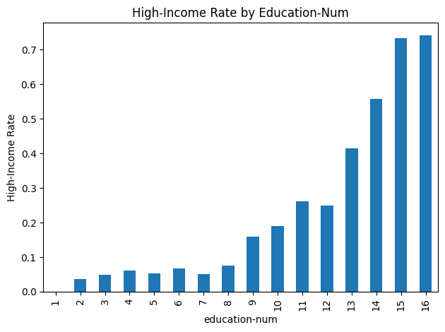
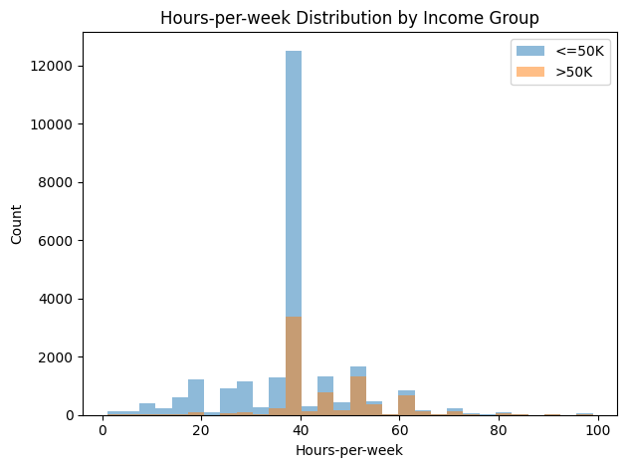
Analyze data
Statistical Analysis
We used visualizations to explore patterns between demographic and work-related variables and income status. This step helped us identify potential relationships before formal testing.
For numerical variables such as hours worked per week, we used t-tests to determine whether there were statistically significant differences in the means between income groups (≤$50K vs. >$50K).
For categorical variables such as marital status, occupation, and capital gains, we used chi-square tests of independence to evaluate whether the distribution of high-income status differed across categories.
All tests produced statistically significant results (p < 0.01), indicating that these variables are meaningfully associated with income level.
This combination of visual inspection and hypothesis testing provided a clear foundation for subsequent predictive modeling.

Slide 9
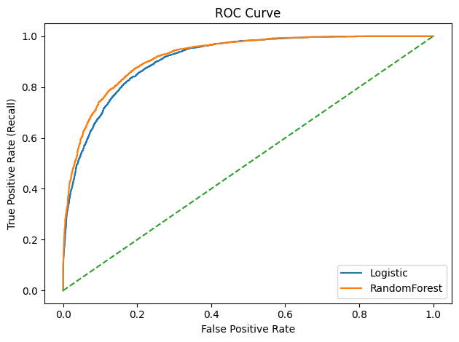
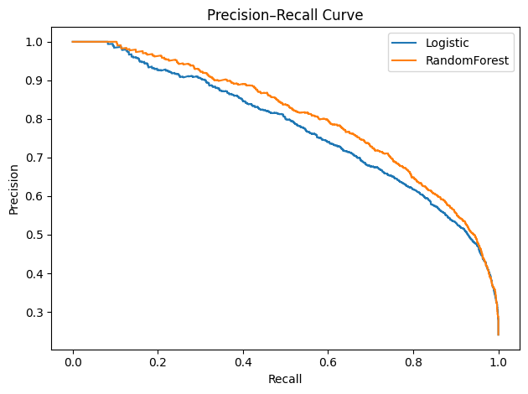
Analyze data
Predictive Modeling Approach
After identifying significant relationships, we built predictive models to assess how well these factors jointly predict whether an individual earns more than $50K annually.
We used Logistic Regression for its interpretability, which allows us to understand the direction and magnitude of each variable’s effect.
We also used Random Forest, which can capture non-linear relationships and interactions between variables without requiring explicit specification.
Both models were trained on a stratified train/test split to maintain class balance.
We evaluated model performance using multiple metrics — accuracy, precision, recall, F1 score, ROC-AUC, and PR-AUC to ensure a balanced understanding of performance given the 24% positive class rate.

Slide 10
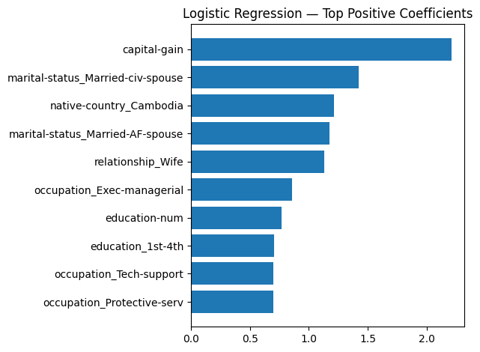
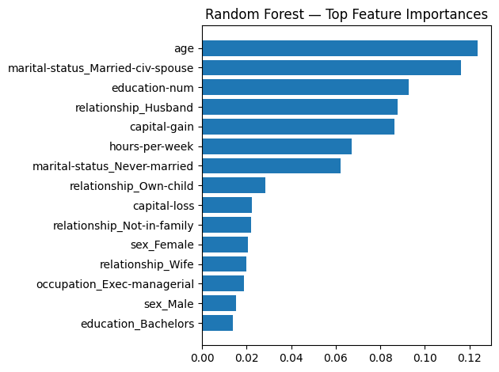
Analyze data
Predictive Modeling Results
Both models performed strongly, with Random Forest achieving ROC-AUC ≈ 0.92 and PR-AUC ≈ 0.80, and Logistic Regression achieving ROC-AUC ≈ 0.91 and PR-AUC ≈ 0.77.
These results indicate that the selected features collectively provide substantial predictive power for identifying individuals earning >$50K.
Logistic Regression revealed positive coefficients for capital gains, higher education levels, being married, and certain occupations, while negative coefficients were observed for “Never-married,” lower-skill occupations, and female sex.
Random Forest identified age, marital status, education-num, capital gains, and hours worked per week as the top global predictors, reinforcing the findings from logistic regression.
The consistency between the two models increases confidence in the robustness of these findings.

Slide 11
Report
Higher levels of education are associated with higher income, supported by both chi-square tests and model outputs.
Individuals working more hours per week are more likely to earn >$50K, as shown by t-tests and partial dependence plots.
Marital status and occupation are strongly related to income; married individuals and those in managerial or technical roles have higher income rates.
Reporting capital gains is one of the strongest predictors of high income.
Predictive models demonstrate that these factors can effectively rank individuals by their probability of earning >$50K, offering analytical and practical value.
While these relationships are strong, they are associational rather than causal.

Slide 12
Act
<apply results, connect results with the chosen problem statement or business question>

